Slide 1
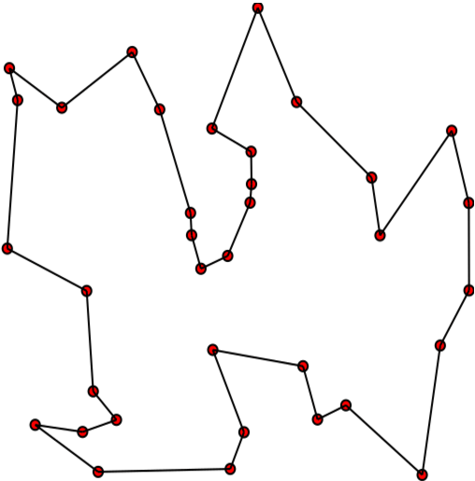
Travelling Salesman Problem using Particle Swarm Optimization
Made By:
Rakshit Pensalwar (71700489K)
Shubham Patil (71700447D)
Chakor Pandkar (71700425C)

Slide 2
ABSTRACT
The aim is to present a collective intelligence approach to help solving optimization problems and apply it in particular to the Travelling Salesman Problem(TSP).
The approach used is the particle swarm optimization (PSO) whose main idea is to simulate the collective behavior of a cloud.

Slide 3
What is TSP?
The travelling salesman problem (TSP) asks the following question: "Given a list of cities and the distances between each pair of cities, what is the shortest possible route that visits each city exactly once and returns to the origin city?"
It is an NP-hard problem in combinatorial optimization, important in operations research and theoretical computer science.
The TSP has several applications even in its purest formulation, such as planning, logistics, and the manufacture of microchips. Slightly modified, it appears as a sub-problem in many areas, such as DNA sequencing.

Slide 4
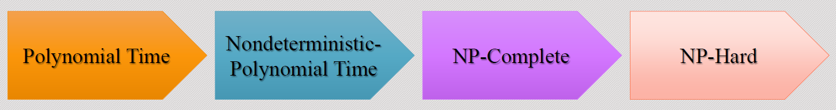
DESCRIPTION
TRAVELLING SALESMAN PROBLEM (TSP) is basically:

Slide 5
INTRODUCTION
There's always a need to find optimal configurations from a discrete set of objects. This is known as a combinatorial optimization problem. While many of these combinatorial optimization problems can be solved in polynomial time, a majority belongs to the class of NP-hard problems .
To face these hard combinatorial optimization problems, A class of heuristic algorithms: meta-heuristic algorithms, was developed showing, at the same time, promising results in the field of combinatorial optimization. This class includes: Particle Swarm Optimization (PSO), Simulated Annealing (SA), Tabu Search (TS), Genetic Algorithms (GA),etc..

Slide 6
Solving TSP using PSO
Particle Swarm Optimization (PSO) has a good potential for problem solving.
The susceptibilities and charms of this nature based algorithm convinced researchers to use the PSO to solve NP-Hard problems such as TSP and Job-Scheduling.
Here, we investigate some of these proposed approaches for solving the TSP.

Slide 7
-One of the attractive works for solving the TSP was cited in (Yuan et al.., 2007).
-They propose a novel hybrid algorithm which invokes the sufficiency of both PSO and COA (Chaotic Optimization Algorithm).
-In fact, they exert the COA to restrain the particles from getting stock on local optima’s in rudimentary iterations.
-In other words, they claim that the COA could considerably useful to keep particle’s global searching
ability.

Slide 8
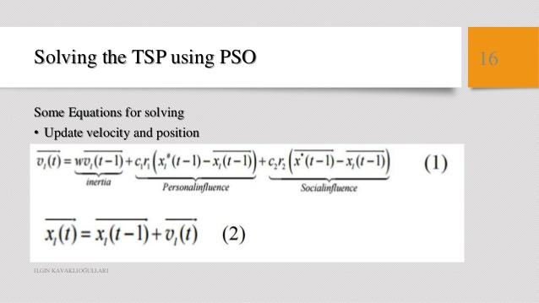

Slide 9
STEPS TO SOLVE TSP
(1)Create a ‘population’ of agents (called particles) uniformly distributed over X (feasible region) and evaluate each particles’ position according to the objective function,
(2)Update particles’ velocities,

Slide 10
(3) Move particles to their new positions,
(4) If a particles’ current position is better than its previous best position, then update it. By doing this, you can be sure to find the best strategy for solution of TSP.

Slide 11
PSO Algorithm
In the classical PSO algorithm, each particle
• has a position and a velocity
• knows its own position and the value associated with it
• knows the best position it has ever achieved, and the value associated with it
• knows its neighbors, their best positions and their values
The best position a given particle has ever achieved is called pbest. In some versions of particle swarm algorithm the particles also track the best position achieved so far by any particle of the swarm. This position is called gbest. By changing their velocities with individualistic moves or toward pbest and gbest, the particles change their positions.

Slide 12
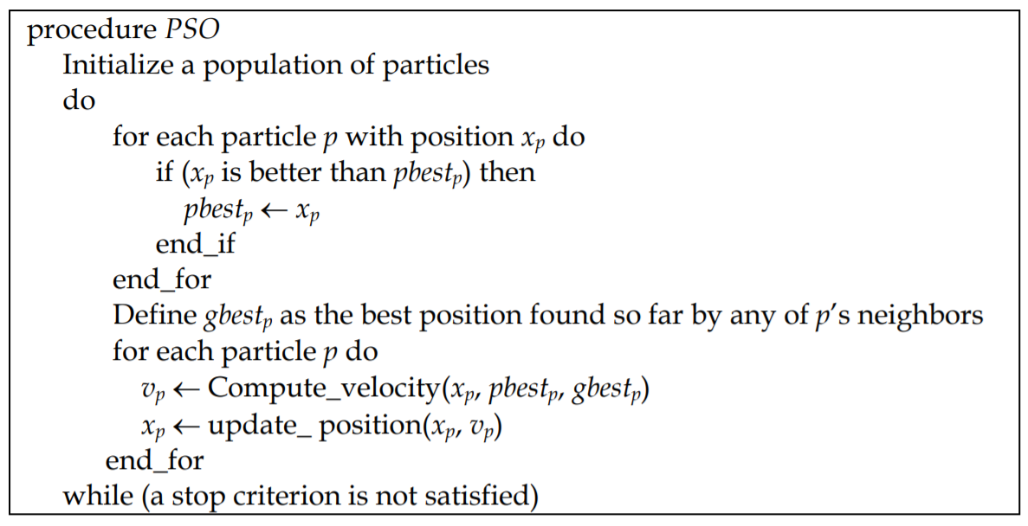
PSO Algorithm (Contd.)

Slide 13
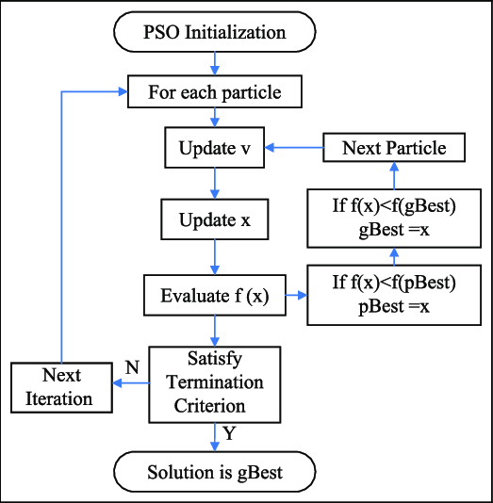
FLOWCHART

Slide 14
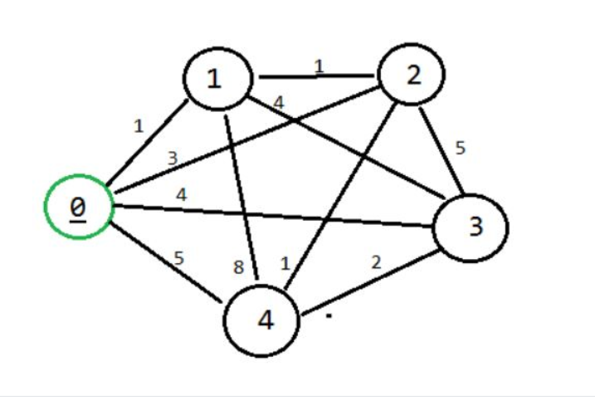
EXAMPLE

Slide 15
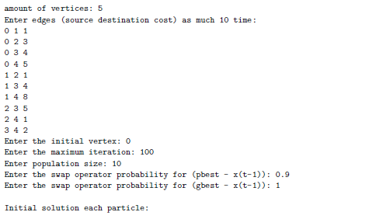
SCREENSHOTS

Slide 16
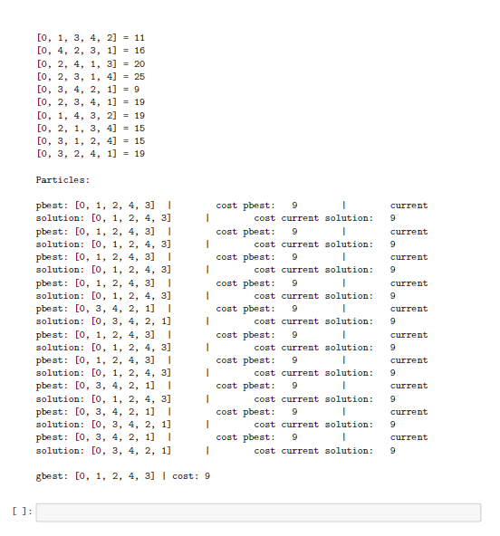

Slide 17
APPLICATION
Find the shortest possible route that visits each city exactly once and returns to the origin city => Hamiltonian cycle .
Posed such computational complexity that any programmable efforts to solve such problems would grow super- polynomially with the problem size.
Can be used in:
• Transportation: school bus routes, service calls, delivering meals
• Manufacturing: an industrial robot that drills holes in printed circuit boards
• VLSI (microchip) layout
• Communication: planning new telecommunication networks

Slide 18
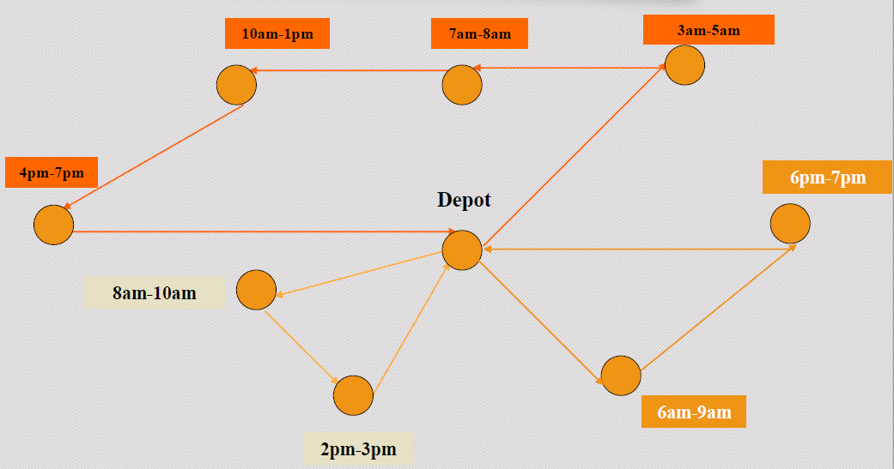
VEHICLE ROUTING

Slide 19
CONCLUSION
This project summarized to develop PSO algorithms for the TSP. Many of the PSO algorithms presented previously for the investigated problem do not tackle large instances and present results far from the best known heuristic solutions obtained by effective algorithms.
The new approach, first introduced by Goldbarg et al. (2006a), differentiates velocity operators according to the type of move the particle does. Additionally, methods to compose the velocity operators were proposed.
Computational experiments with instances up to 7397 cities were presented. The results of those experiments show that the proposed method produces high quality solutions, when compared with four effective heuristics designed specifically for the investigated problem.

Slide 20
REFERENCES
[1] Goldbarg, E.F.G; Souza, G.R. & Goldbarg, M.C. (2006a). Particle swarm for the traveling salesman problem, Proceedings of the EvoCOP 2006, Gottlieb, J. & Raidl, G.R. (Ed.), Lecture Notes in Computer Science, Vol. 3906, pp. 99-110, Budapest, Hungary, April 2006, Springer, Berlin.
[2] Kennedy, J. and Eberhart, R. (1995). Particle Swarm Optimization, Proceedings of IEEE International Conference on Neural Networks, pp. 19421948, 27th November – 1 December, 1995.
-PPT by:
Rakshit Pensalwar (71700489K)

